Slide 1
Rapid Reach (Real-Time Emergency Locator)
Presented by
Ambhoj Adhikari
[Reg No.: 6-2-144-01-2020]

Slide 2
Table of Content
Introduction of project
Problem statement
Objectives of project
Scope and limitations
Methodology
Algorithm used
conclusion

Slide 3
Introduction of the Project
Rapid Reach is a real-time emergency locator platform designed to connect users with nearby essential services when urgency strikes.
The website provides instant access based on the user's current location and simplifies the process of finding help by allowing users to search by category and view crucial details such as distance, availability, and working hours.

Slide 4
Problem Statement
In the context of Nepal, peoples are facing numerous challenges related to health services.
The problems such as:
No centralized platform for services like Fire Department, Health Service and Police Departments.
Lack of real-time access and direct communication.
Delay in response time.

Slide 5
Objectives of project
The objectives of this project which are mainly focused are mentioned below:
To develop a real-time live tracking system for ambulance, fire truck and police vehicle.
To reduce emergency response time by applying call now feature.
To recommend nearby departments like hospitals, fire department and police department along with vehicles services like ambulance, fire truck and police vehicle.

Slide 6
Scope and Limitations
Scopes
It provides the services with the help of real-time search, location and contact.
It displays essential details like availability, working hours, distance, verification status, and ratings.
It enables direct calling to emergency services from within the platform.

Slide 7
Scope and Limitations
Limitations
It does not provide medical, legal, or emergency advice.
It is only made for two municipality including Kathmandu and Chandragiri.

Slide 8
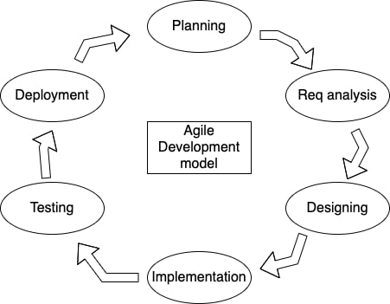
Methodology

Slide 9
Algorithms
Haversine Algorithm
The Haversine algorithm calculates the shortest distance between two points on the surface of a sphere, such as Earth, based on their geographic coordinates (latitude and longitude). It uses spherical trigonometry to account for the Earth's curvature, rather than assuming a flat plane. The algorithm computes the "great-circle distance," which is the shortest path between two points along the surface of a sphere.

Slide 10
Algorithms
Priority Scoring Algorithm
The Priority Scoring Algorithm ranks items, tasks, or requests based on a set of criteria and assigns them a score to determine their priority or importance. The algorithm is typically used in resource allocation, scheduling, and decision-making processes where tasks or items need to be evaluated and sorted based on predefined factors such as urgency, value, or other weighted attributes.

Slide 11
Conclusion
Rapid Reach addresses a critical need for a fast, reliable, and user-friendly emergency response tool, especially in regions like Nepal where access to real-time emergency information is often limited. By centralizing essential services such as hospitals, police stations, fire services, ambulances, and blood banks, the platform empowers users to act swiftly during emergencies and reduces the time taken to reach help.

Slide 12
Thank you

